Slide 1


Gestures Volume: Volume control with Hand Gesture
Presented by:-
SNEHIL GHOSH
AMRUTHA VERSHINI GARI
GAUTAM N CHIPKAR
AYUSH GORGE
Mentor: Dr. D. Bhanu Prakash

Slide 2
Project Statement
Building a computer vision-based application that enables users to
control their system volume using predefined hand gestures.
By detecting hand landmarks from a webcam feed using MediaPipe and
interpreting the geometric relationships between them, the application
translates specific gestures (such as pinch distance ) into volume
control signals.
The System eliminates the need for physical contact, making it suitable
for smart environments, assistive technology, and touch-free control
systems.

Slide 3
Expected outcome
Expected Outcomes:-
The application will be able to process real-time webcam input and accurately track hand movements.
It will detect hand landmarks using the MediaPipe Hands module.
The system will classify gestures based on hand geometry, such as the distance between the thumb and index finger.
It will map gesture measurements to dynamic system volume control levels.

Slide 4

Setup
OpenCV (cv2)
Library for real-time computer vision, used to:
Access webcam frames
Convert BGR ↔ RGB images
Matplotlib
Visualisation library used inside the Tkinter HUD to:
Draw Arc-Reactor styled polar volume meter
Render Z-axis proximity bar
Tkinter
Python’s built-in GUI framework, responsible for:
Main application window
HUD layout structure
Video preview, Embedding Matplotlib graphs, Responsive UI and status updates
NumPy
Fundamental library for numerical computation, used to:
Calculate distances & interpolations
Handle arrays of frame metrics
Compute scaling, aspect ratios and smoothing metrics
Pycaw (Python Core Audio Windows Library): Key library enabling microphone volume control:
Interfaces with Windows Audio Session API (WASAPI)
Gets/sets microphone volume level
Requires COM interaction → moved into child process for stability
MediaPipe Hands
Google’s ML framework for hand tracking, used to:
Detect hands in webcam feed
Track 21 hand landmarks
Extract gesture-related measurements

Slide 5
Setup
threading & queue
Used to handle asynchronous tasks:
Background threads for reading subprocess output
Non-blocking queues for safe communication
Ensures UI thread stays responsive
PIL / Pillow
Image processing library used to:
Convert NumPy arrays → Tkinter-compatible images
Resize frames with LANCZOS filtering
Support smooth rendering of webcam preview
Jupyter Notebook (Development Environment)
Used during development for:
Testing MediaPipe outputs
Plotting and debugging graphs
Iterative experimentation with frame processing
Easy visualisation and step-by-step execution
Comtypes (COM Interface Library)
Used for interacting with Windows COM components:
Activates audio endpoint (microphone)
Communicates with IAudioEndpointVolume
Requires strict threading (reason for child subprocess isolation)

Slide 6
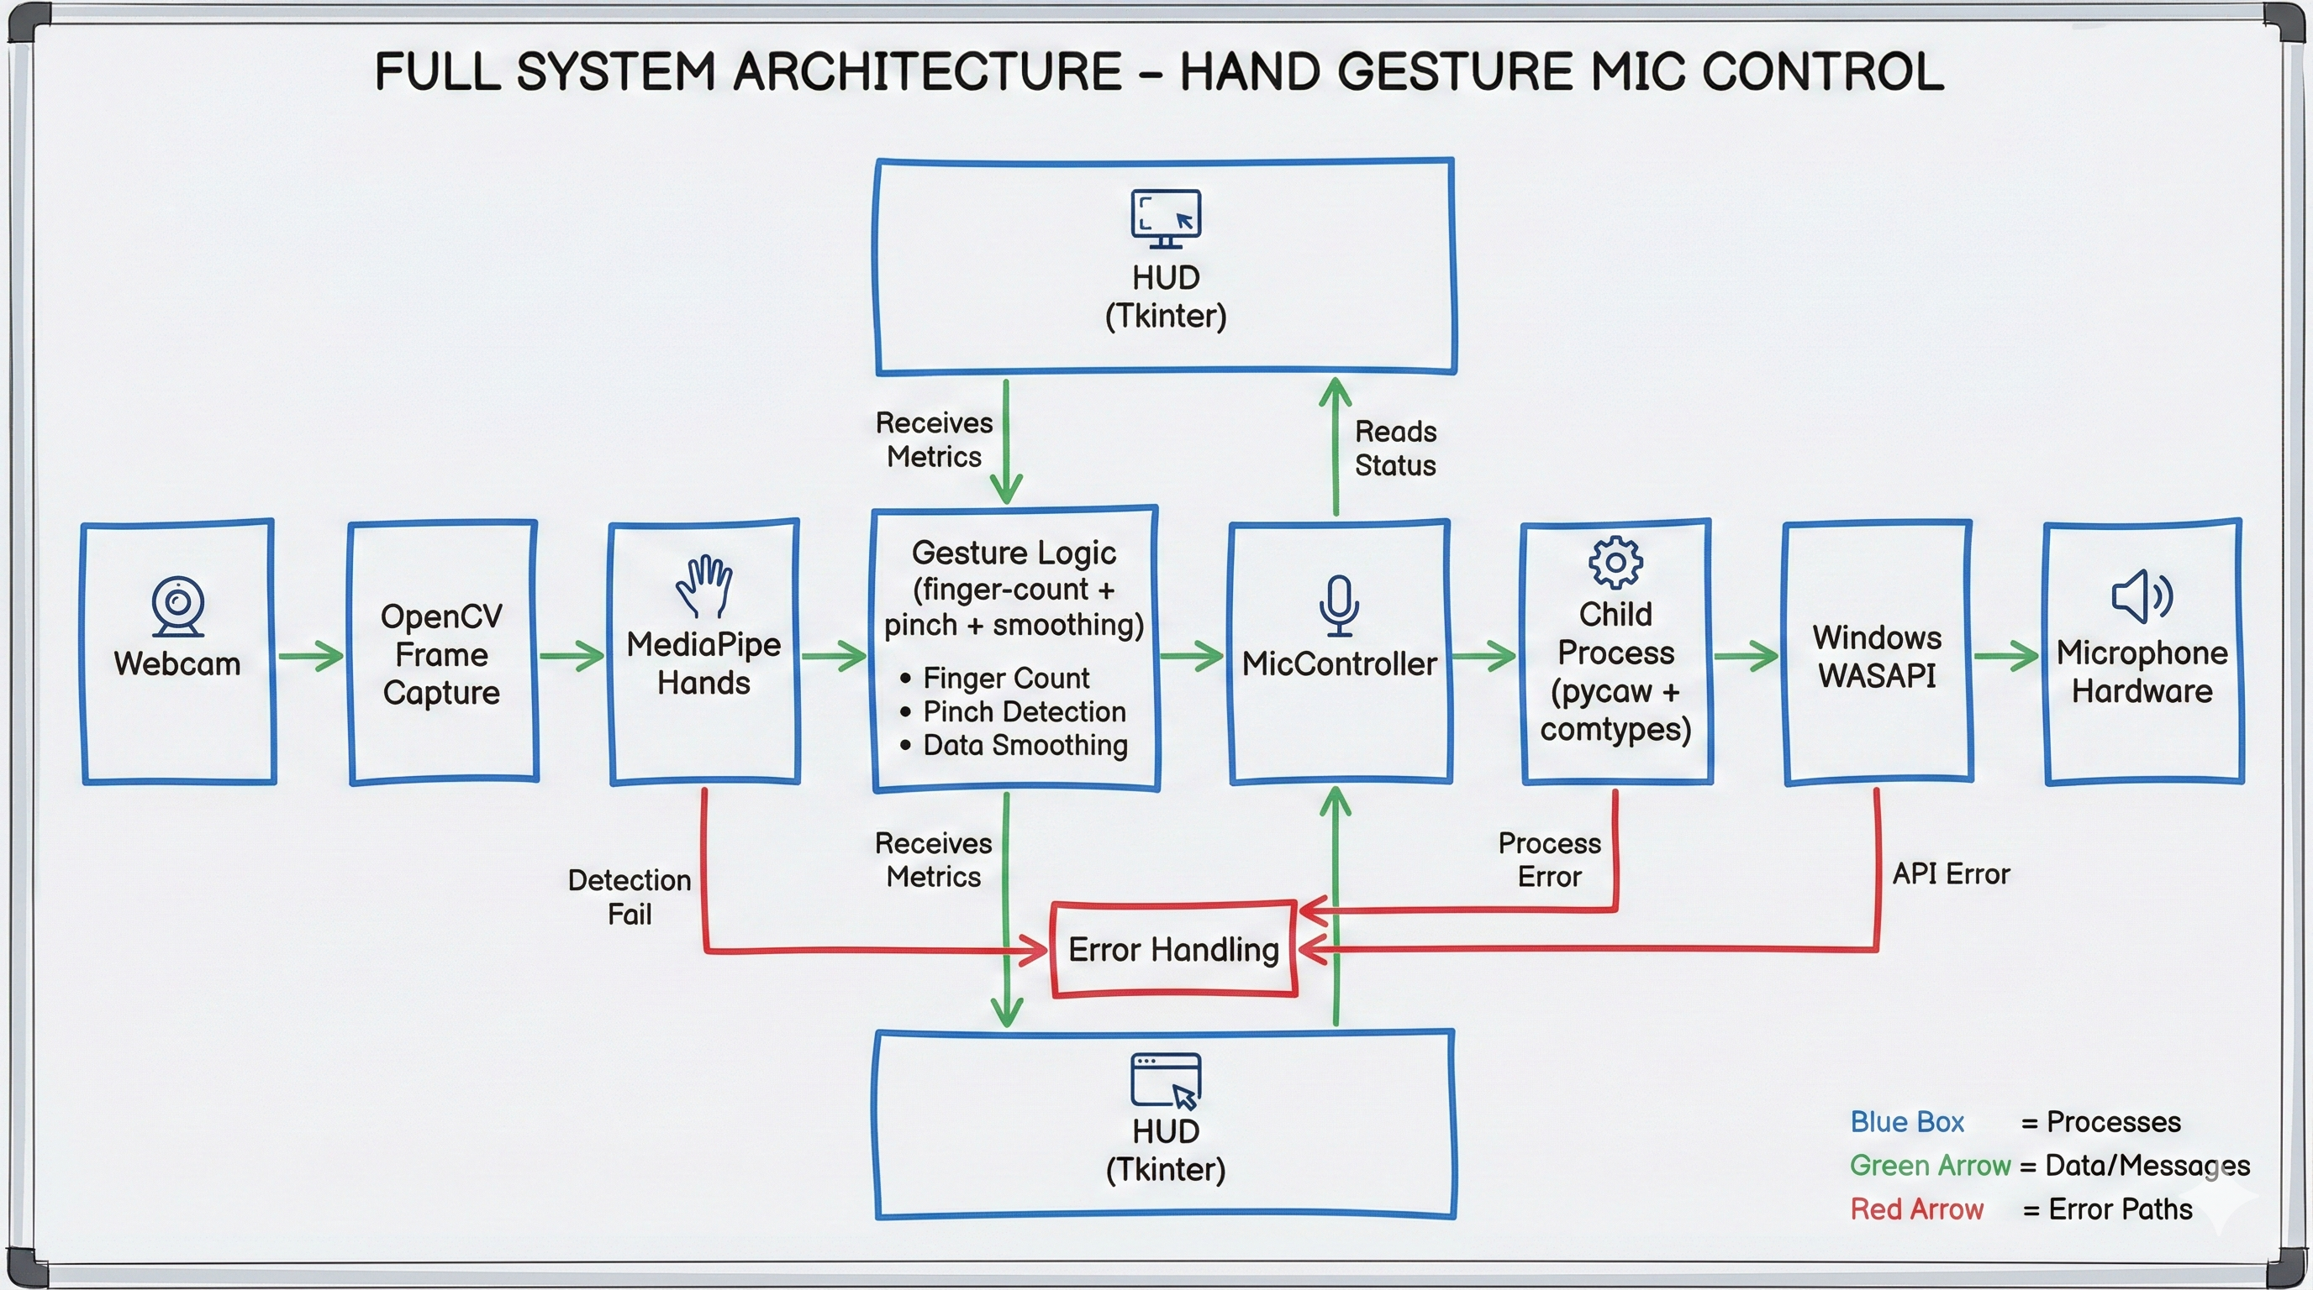
Full System Architecture

Slide 7
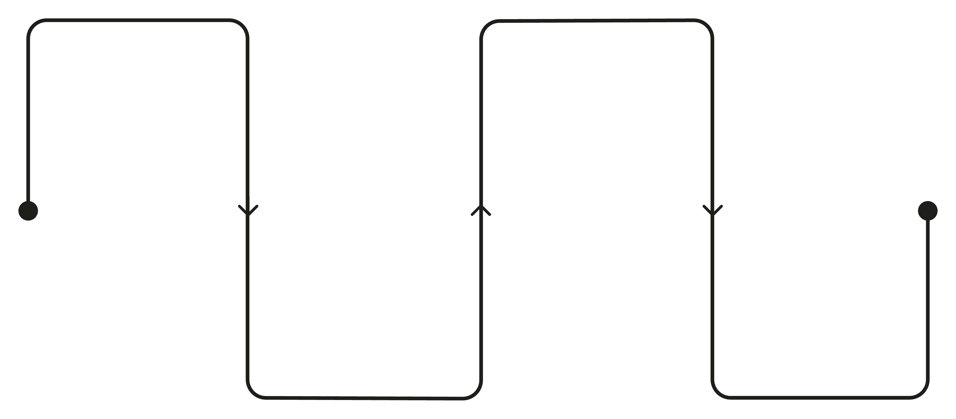
MediaPipe Two-Stage Architecture
MediaPipe Hands does not rely on a single, monolithic CNN for hand tracking. Instead, it employs two distinct, task-optimized convolutional neural networks arranged in a sequential pipeline. This architectural decision stems from a fundamental insight: detecting the presence and location of a hand is a fundamentally different computational problem than precisely localizing individual finger joints and articulation points.
STAGE 1: PALM DETECTION
STAGE 2: LANDMARK REGREATION
MediaPipe Hands: Two-Stage Pipeline
Hand (Palm) Detection Stage
Detects presence of a hand
Outputs a bounding box
Hand Landmark Detection Stage
Predicts 21 hand landmarks
Provides precise finger joint positions
Optimized for real-time execution
Runs efficiently on CPU
Binary detection + bounding box
Predict 21 precise hand landmarks
TRANSITION
BENEFITS
Crop ROI and pass to regressor
Accuracy, efficiency, speed, stability

Slide 8
CNN
CNN 1: Palm Detection
CNN 2: Hand Landmark Detection
Purpose: Detect whether a hand exists and where
Architecture: Single Shot Detector (SSD)
Input: Full webcam frame
Output: Rough palm bounding box + confidence score
Why SSD:
Single forward pass
No region proposals
Low latency → real-time on CPU
Key Trait: Rotation & scale invariant
Purpose: Fine-grained hand understanding
Architecture: Regression-based CNN
Input: Cropped ROI from palm detector
Output:
21 landmarks × (X, Y, Z)
Total = 63 continuous values
Covers:
Finger joints (MCP, PIP, DIP)
Fingertips
Wrist
Relative depth (Z-axis)

Slide 9
System Configuration (End-User)
Minimum Supported Configuration
OS: Windows 10
Processor: Dual-core CPU
RAM: 4 GB
Webcam: Basic 480p (reduced accuracy)
No GPU required
⚠️ Performance may degrade under low light
Recommended System Configuration
OS: Windows 10 / 11 (64-bit)
Processor: Intel i5 / Ryzen 5 or higher
RAM: 8 GB minimum
Camera: Integrated or USB webcam (720p+)
Microphone: Any WASAPI-compatible mic
Python Environment (bundled in exe)

Slide 10
OpenCV Helps in Gesture Recognition
OpenCV is the vision engine of your project. It does not understand gestures by itself — but it provides the raw visual data pipeline required for MediaPipe to do its work.
Think of it as the camera operator in a movie production.
✅ What OpenCV actually does conceptually
Accesses real-time webcam feed
Opens the hardware stream
Manages frame-by-frame extraction
Handles camera drivers, buffering, and performance
Delivers clean frames for processing
Flips the image (mirror view)
Converts BGR → RGB (required by MediaPipe)
Resizes or normalizes if needed
3. Provides a stable, constant-speed video loop
Ensures every frame reaches the hand-detection model
Maintains 20–30 FPS so gesture detection feels instant
4. Acts as the visual “world interface”
Without OpenCV, MediaPipe has nothing to analyse
It is the bridge between hardware → AI model

Slide 11
How Audio APIs Help in Gesture
Where OpenCV is the eyes, Pycaw/WASAPI serves as the hands that control the microphone.
Gesture detection alone is useless unless it can change something in the system. That “something” is the microphone input volume.
✔️ What the Audio API does conceptually
Provides access to the Windows Audio Stack (WASAPI)
WASAPI controls hardware input/output
Pycaw exposes this through Python
You get a handle to the default microphone endpoint
2. Lets you read/write microphone volume safely
GetMasterVolumeLevelScalar() → Read current %
SetMasterVolumeLevelScalar() → Apply new %
3. Allows full control with zero UI interactions
No need to open Windows Sound Panel
No need to change OS settings manually
4. Integrates seamlessly with gesture output
Gesture value (0–5) → Volume % (0–100)
Pinch → Fine control using pixel distance
Open palm → High volume
Closed hand → Mute/Low volume
5. COM stability ensures accurate, real-time volume updates
That’s why the child process is used
COM must run in a dedicated, single-threaded environment

Slide 12
Pycaw problem
Pycaw internally uses Windows Core Audio COM interfaces, which have strict threading & initialization rules. Tkinter’s main thread, hotkey threads, and gesture-processing loops all interfere with stable COM usage. Running CoInitialize multiple times or from unpredictable threads leads to undefined behaviour — typically:
COM initialisation errors
Random crashes
Memory access violations
Volume endpoint returning null or invalid pointers
In Python, the GIL does not protect Windows COM, meaning threads still behave differently at the OS-level. MediaPipe and Tkinter add additional complexity — both spawn native code operations that COM cannot safely coexist with in the same thread.

Slide 13
Remedy
The child process solves the COM instability by isolating pycaw inside a dedicated interpreter instance.
It initializes COM exactly once using CoInitialize(), avoiding thread collisions.
No Tkinter, MediaPipe, or hotkey threads ever touch this process.
Only clean text commands pass through stdin/stdout.
This prevents:
Invalid COM pointer reuse
Random crashes caused by mixed native threads
Conflicting initialisation calls
By separating audio logic, COM gains a stable execution environment. This isolation ensures predictable microphone control and safe handling of Windows Core Audio interfaces.

Slide 14
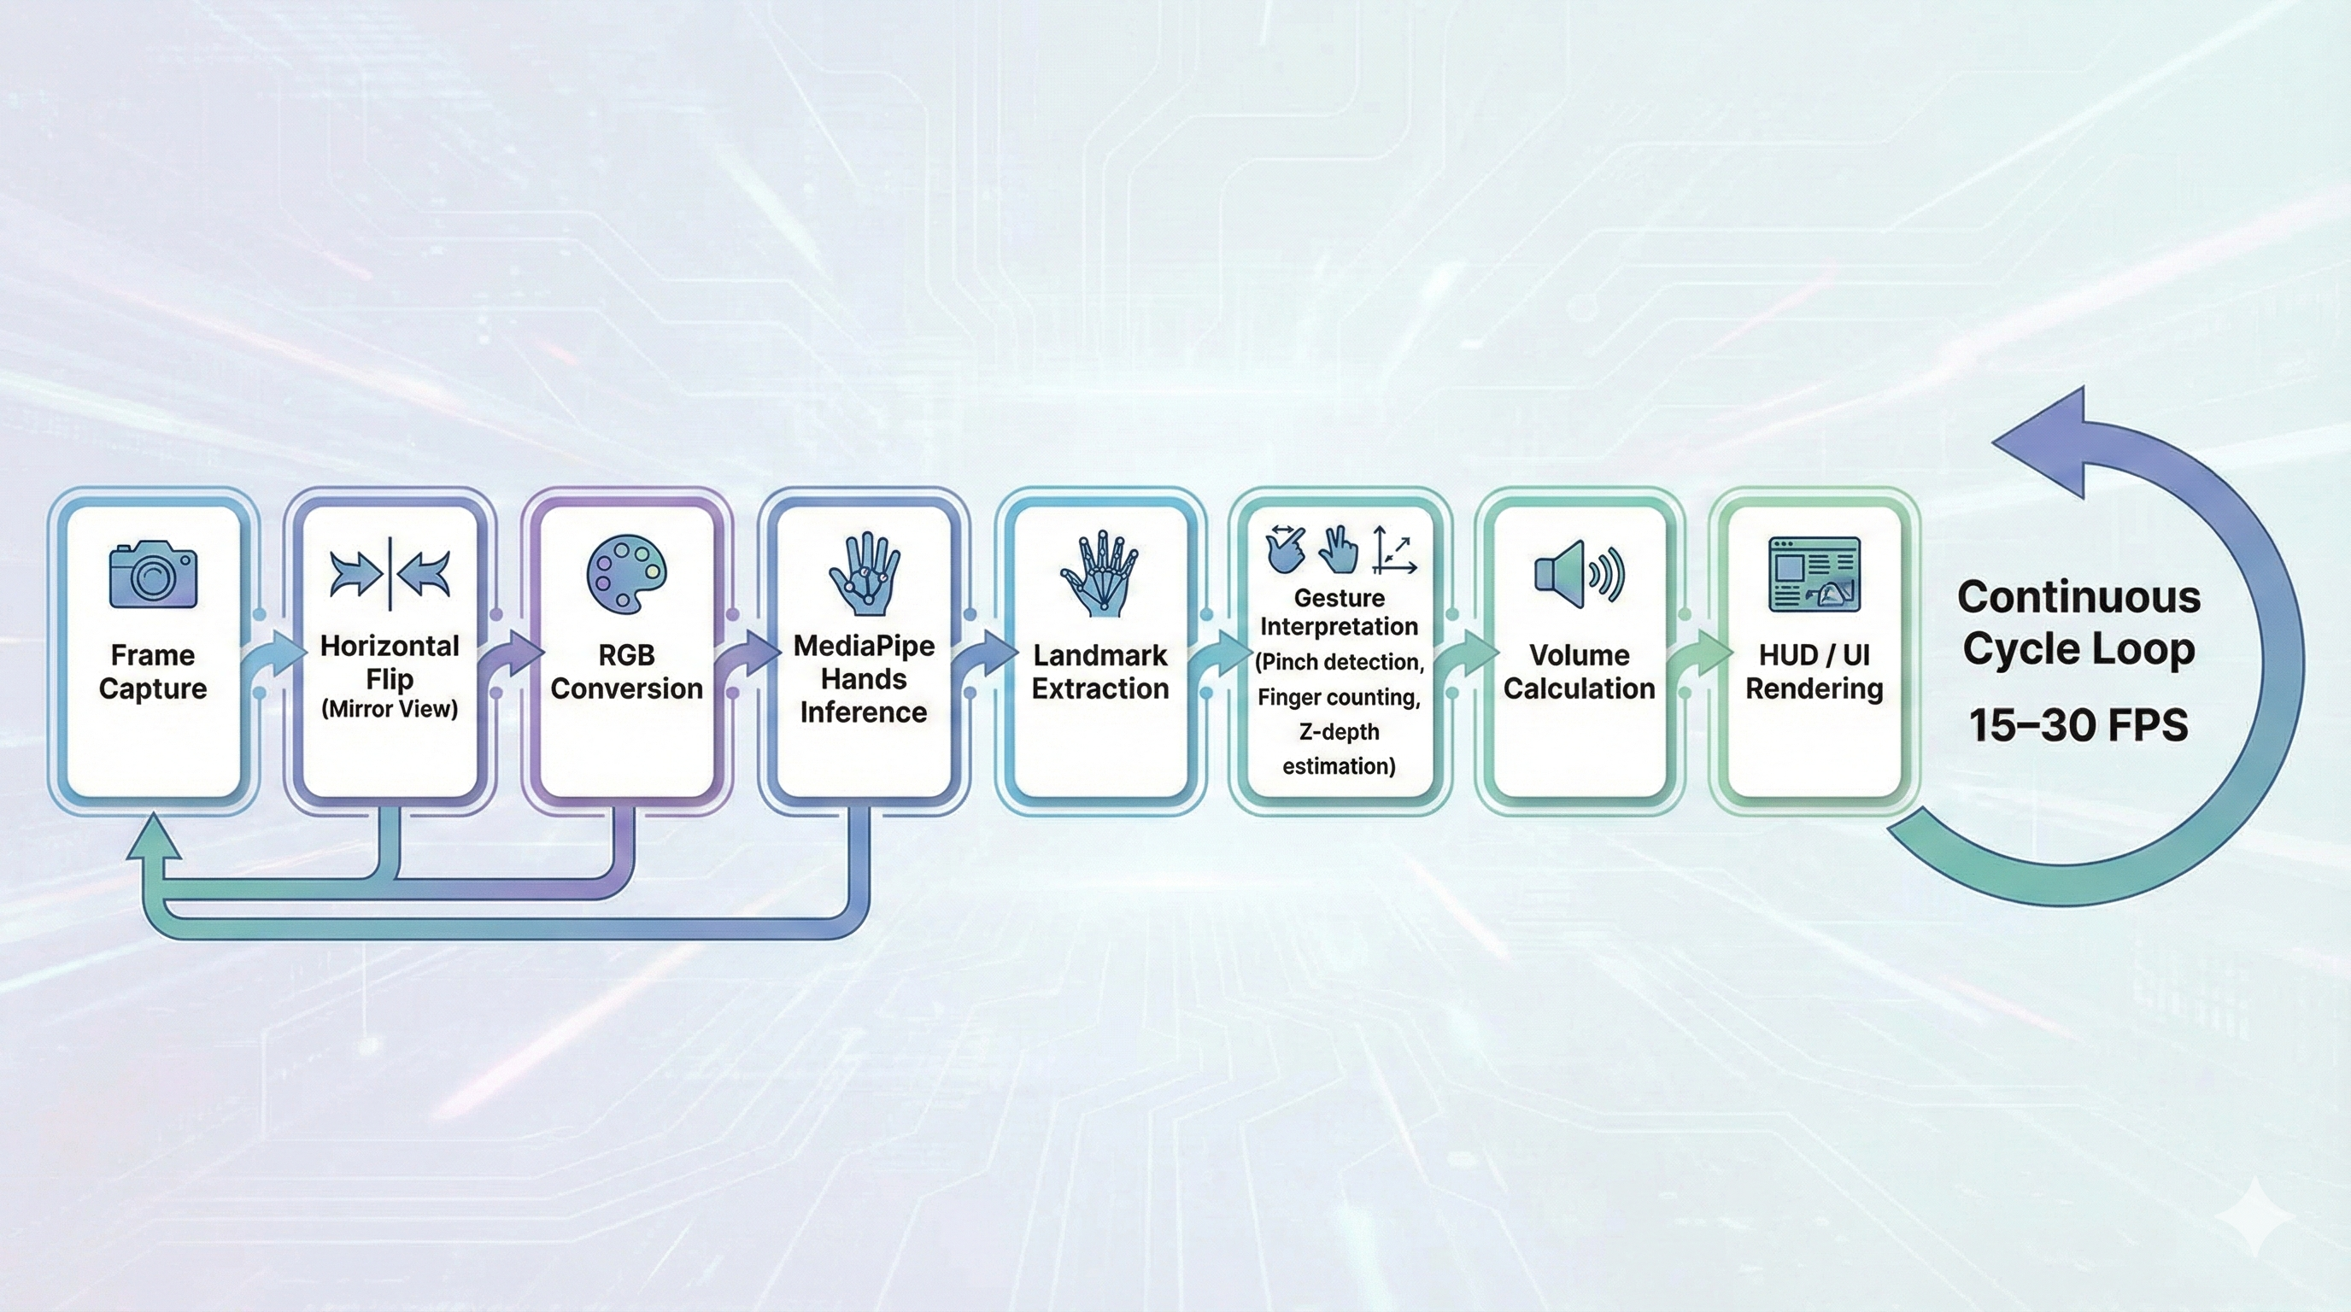
Gesture Processing Pipeline

Slide 15
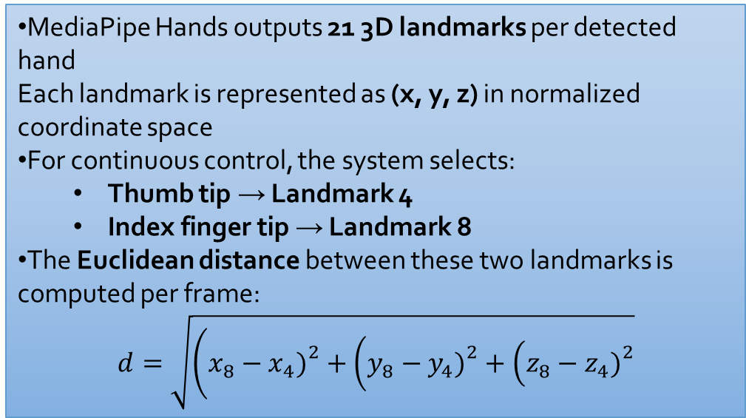
Distance Computation & Volume Scaling
MediaPipe Hands outputs 21 3D landmarks per detected hand Each landmark is represented as (x, y, z) in normalized coordinate space
For continuous control, the system selects:
Thumb tip → Landmark 4
Index finger tip → Landmark 8
The Euclidean distance between these two landmarks is computed per frame:
$$d=\sqrt{\left(x_{8}−x_{4}{\left.)\right.}^{2}+\left(y_{8}−y_{4}{\left.)\right.}^{2}+\left(z_{8}−z_{4}{\left.)\right.}^{2}\right.\right.\right.}$$
This distance serves as a continuous gesture magnitude signal
Smaller d → fingers closer → lower volume
Larger d → fingers farther apart → higher volume
The raw distance is then:
Clipped to predefined minimum and maximum bounds
Linearly interpolated into a 0–100% volume range
To ensure stability:
Minor frame-to-frame fluctuations are ignored
Volume updates are applied only when the change exceeds a step threshold

Slide 16
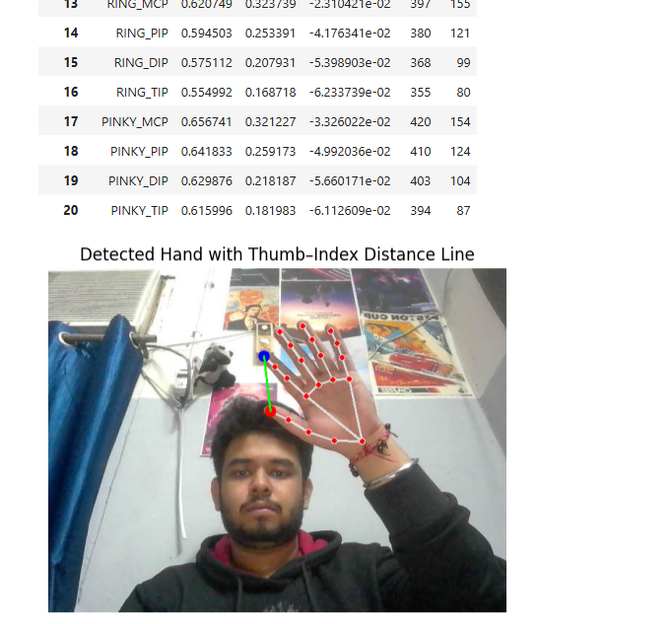
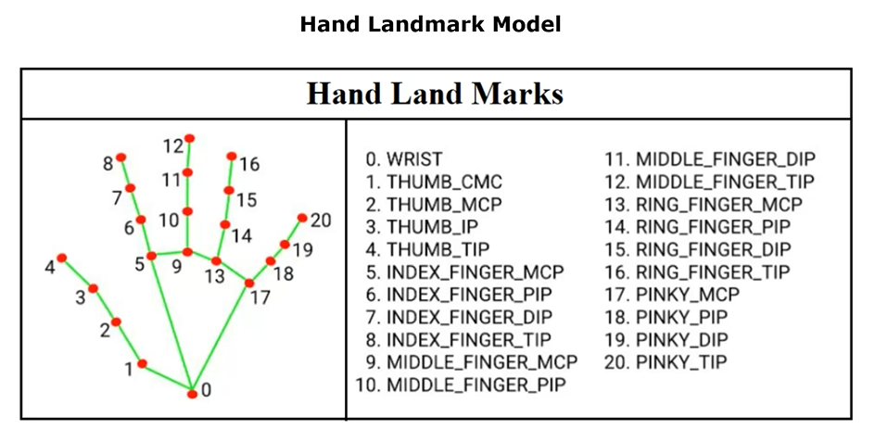
Index tip and thumb tip distance

Slide 17
Thank you

